Slide 1
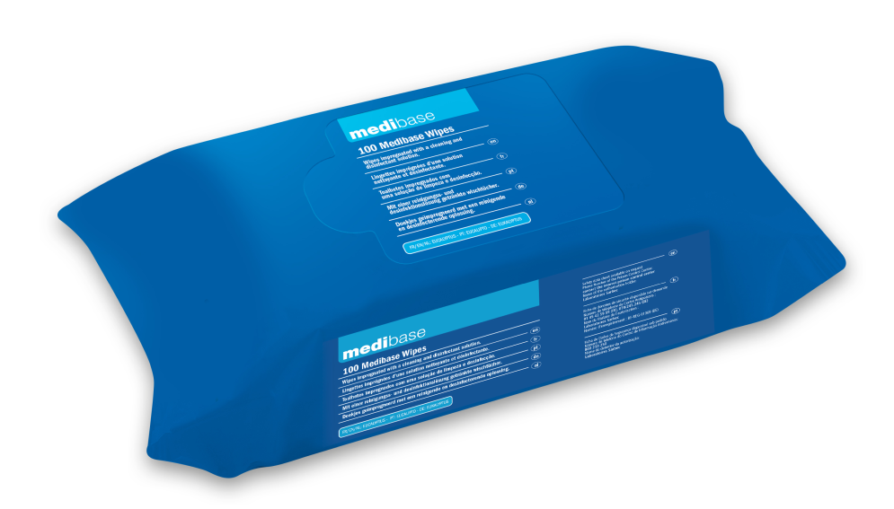
medibase
The new MEDIBASE wipes in flow pack format are now available!
CLEANING AND DISINFECTING WIPES
New formula, eucalyptus fragrance, biocidal status
New flow pack format in thick wipes
Eucalyptus fragrance
Biocidal status
Product characteristics
INDICATIONS :
Wipes impregnated with a cleaning and disinfecting solution
CHARACTERISTICS :
Niaouli (eucalyptus) fragrance
Formulated without alcohol
Non-ionic surfactants <5%
Product labelling without risk phrase
Broad spectrum of antimicrobial activity (bactericide, levuricide and limited-spectrum virucide)
New flow pack format (flexible sachet)
Thick fibre wipes (45g) 340% impregnated
More economical format: covers 2.5x more surface area
Référence Cadence | Description produit
3160746 | LINGETTES MEDIBASE SACHET (100)
PRIVATE LABEL
01/2024

Slide 2
medibase
CLEANING AND DISINFECTING WIPES
New formula, what changes?
Current formula under Medical Device Class IIa status, for use on non-invasive medical devices (small equipment type)
New biocide-status formula for use on hard, non-porous surfaces (such as worktops and dental chairs)
The EN 16615 standard does not work with fine wipes, so we need to switch to thick wipes.
The entry into force in 2020 of the new EU regulation 2017/45 indicates that wipes are used to disinfect surfaces rather than medical devices.
Most manufacturers have therefore decided to switch from DM status to biocidal status, in flow pack format, in order to comply with the new regulation.
Old formula
New formula

Slide 3
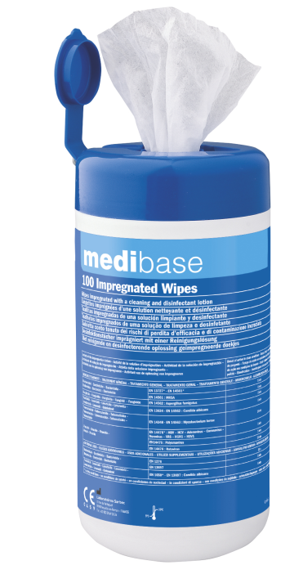
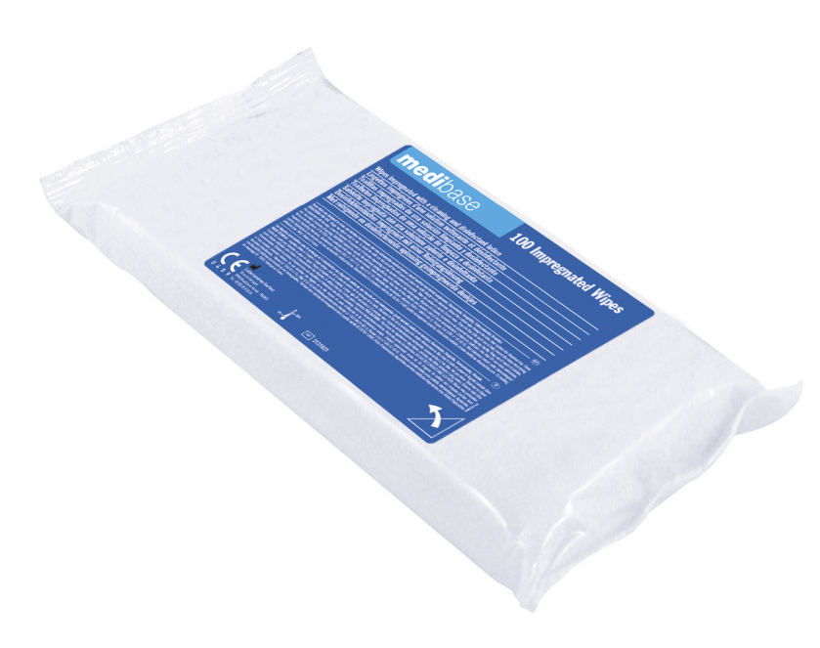
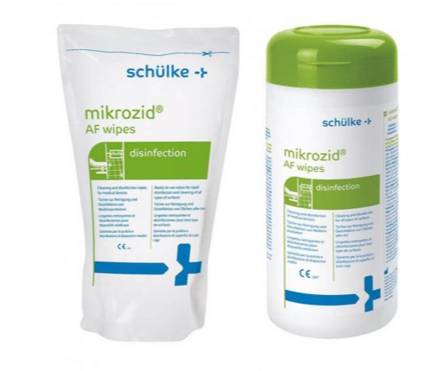
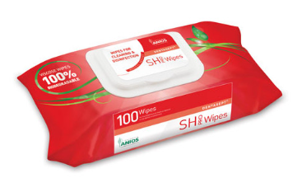
New formulas
Flow pack
Old formula
Box + refill
Box + refill
Dentasapt SH PRO WIPES
Classification
Application
Formula
Format
Size wipes
Impregnation
Grammage
Fragrance
TP2 biocide product | Class IIa medical device | Class IIa medical device + TP2 biocide | Class IIa medical device
Disinfection of hard non-porous surfaces in medical environments, local authorities and places open to the public | Cleaning and disinfection of non-invasive, non-immersible medical devices (small medical and dental equipment) | Rapid alcohol-based disinfection of medical equipmentand all kinds of cleanable surfaces, where there is a risk of infection | Cleaning and disinfection of non-invasive, non-immersible medical devices (small medical and dental equipment)
Active ingredients: didecyldimethylammonium chlorideNon-ionic surfactants <5 | Active ingredients: Ethanol, IPANon-ionic surfactants <5 | Active ingredients: 25 g ethanol (94%), 35 gPropan-1-ol and wetting agents | Substances actives : chlorure de didécyldiméthylammonium
Thick wipes 45g | Fine wipes 23g | Fine wipes 25g | Thick wipes
Flow pack (x100)
Box (x100)
Refill (x100)
Box (x150)
Refill (x150)
Flow pack (x100)
130x200
130x200
140x180
180x200
340%
300%
N/A
N/A
Niaouli (eucalyptus) fragrance
Niaouli (eucalyptus) fragrance
Fragrance-free
Fragrance-free

Slide 4
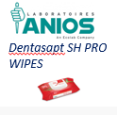
New formula
Flow pack
Old formula
Box + refill
Box + refill
Spectrum of activity
EN 16615
EN 13727
EN 13697
EN 1276
EN 13727
EN 14561
EN 13697
EN 13727
EN 16615
EN 13697
EN 16615
EN 13727
Bactericidal
5 min
5 min
1 min
2 min
EN 16615
EN 13624
EN 13697
EN 1650
EN 13624
EN 14562
EN 13697
EN 1650
EN 16615
EN 13624
EN 13697
EN 16615
EN 13624
2 min
Levuricide
5 min
5 min
2 min
EN 14476
on HBV, HCV, HSV, adéno, noro, corona, VRS, H1N1
EN 14476
on polyomavirus
EN 14476
on rotavirus
1 min
EN 14476
on les virus enveloppés
EN 14476
on polyomavirus
EN 14476
on rotavirus
EN 14476
limited spectrum on adenovirus, norovirus
EN 14476
EN 16777
on adénovirus, norovirus, vaccinia
EN 14476
on HSV, HCV, HIV, coronavirus, rotavirus, herpes
1 min
EN 14476
on noro, VHB, VHC, VHS
EN 14476
on polyomavirus
EN 14476
on rotavirus
5 min
Virucide
5 min
1 min
1 min
5 min
30 sec
30 sec
15 min
*Virucidal activity no longer compliant with new BPR / NF EN 14885 guidelines
30 min

